Slide 1
Competition of Social Opinions on Two Layer Networks (model generalization, future work)
Notes:
My topic is about competition of social opinions on Two layer Network. Today, I focus on model generalization and future work.

Slide 2
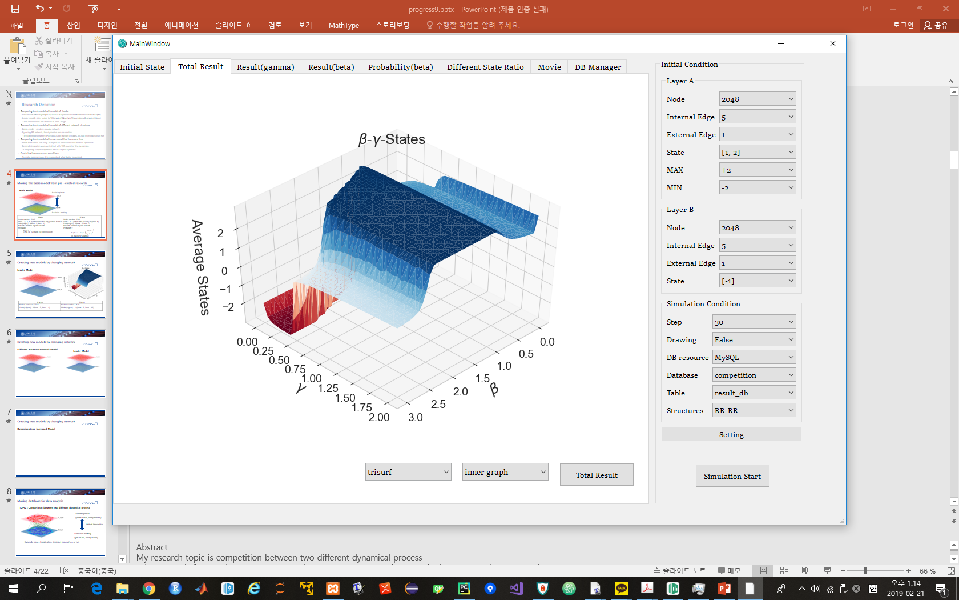
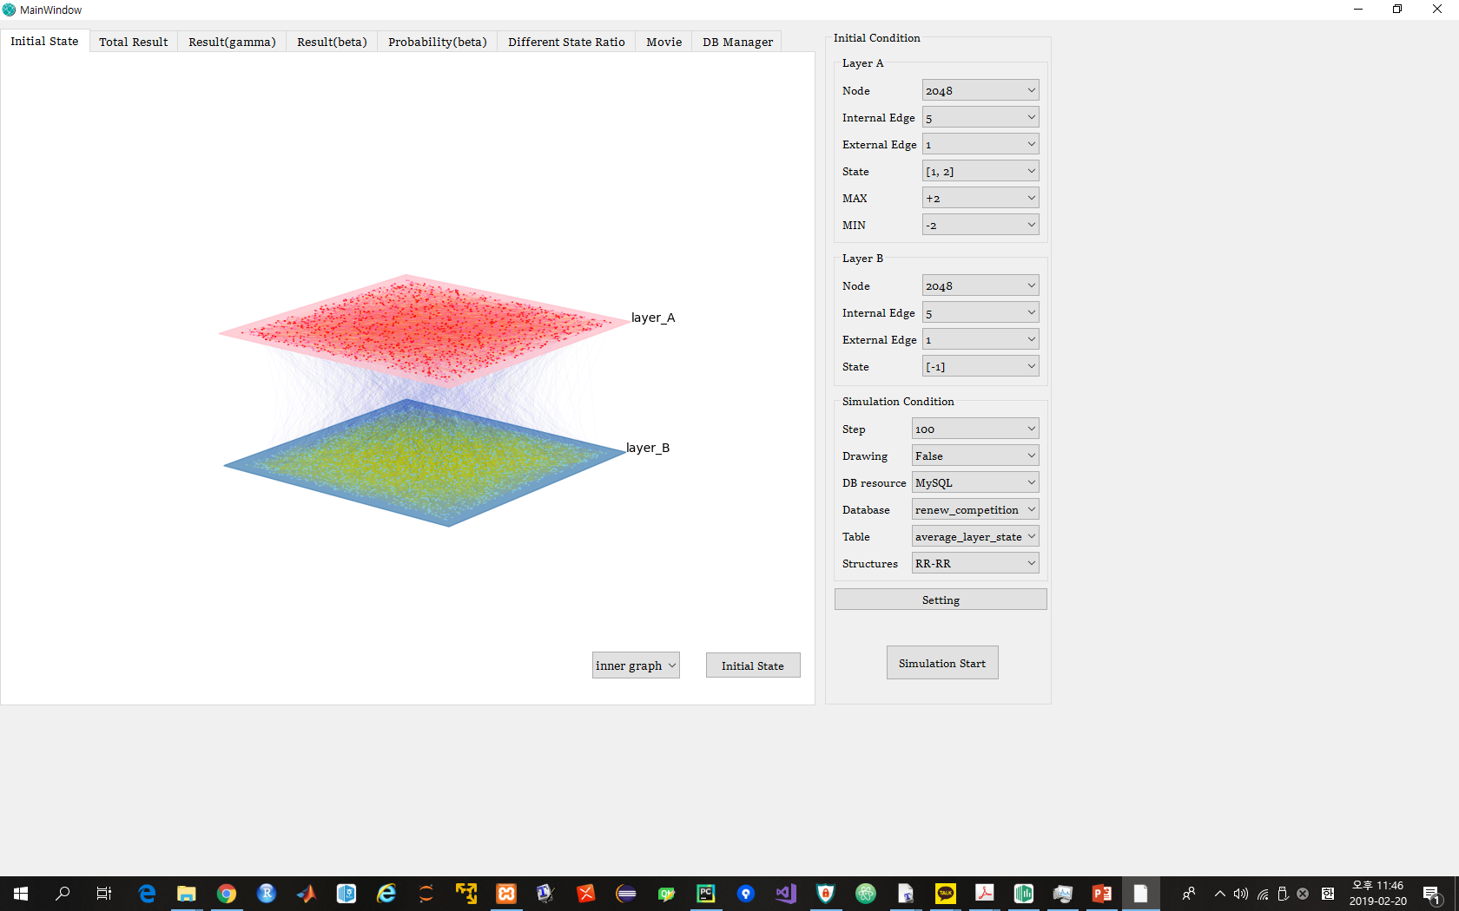
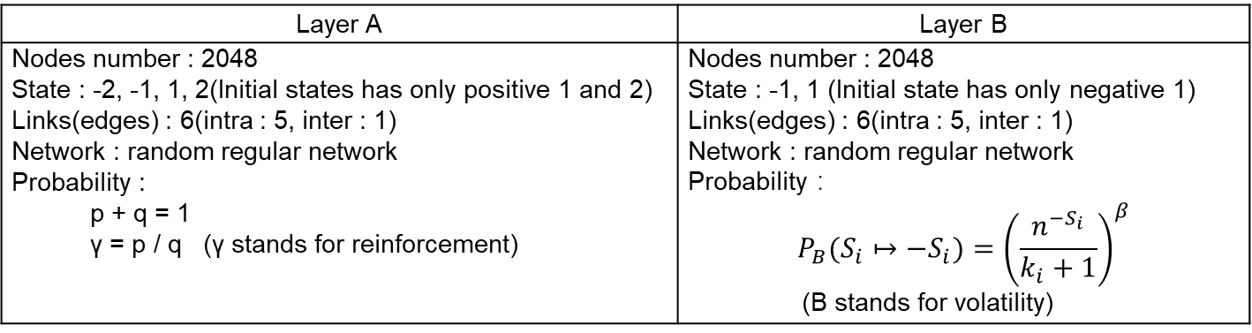
Previous Model
Social opinion
Decision-making
Layer A | Layer B
Nodes number : 2048 State : -2, -1, 1, 2(Initial states has only positive 1 and 2) Links(edges) : 6(intra : 5, inter : 1) Network : random regular network Probability : p + q = 1 γ = p / q (γ stands for reinforcement) | Nodes number : 2048 State : -1, 1 (Initial state has only negative 1) Links(edges) : 6(intra : 5, inter : 1) Network : random regular network Probability ： $$P_{B}(S_{i}↦−S_{i})={\left(\frac{n^{−S_{i}}}{k_{i}+1}\right)}^{β}$$ (Β stands for volatility)
Notes:
This is previous model. Layer A dynamics works with parameter gamma. It stands for reinforcement. Layer B dynamics works with parameter beta. It stands for volatility. This model is specialized model for only 1 external edges.
So I try to generalize the dynamics.

Slide 3
Model generalization
Parameter value scales are adjusted from 0 to 1
- In previous models, parameter value scales are different according
to network structures. γ scales are 0~2, β scales are 0~3 in Random Regular Model
- To simplify parameters, scales are adjusted from 0 to 1
Calculating persuasion and compromise probabilities in layer A
- In layer A dynamics, when two nodes are connected, probability p and q are applied.
- To simplify dynamics, the probability would be calculated that each node change its state
Changing Network structures : RR → BA
- As future work, the key nodes and edges are investigated
- In order to have different centralities on each node, BA network would be applied
Considering Dynamics order as updating rule : Step by step vs Simultaneous
- In previous research, node states were updated by sequential updating rule.
(First, states of nodes in layer A were updated step by step. After that, state of
nodes in layer B were updated step by step)
- For model generalization, simultaneous updating rule would be considered.
Notes:
For model generalization, I am considering 4 main points. First, parameter value scales are adjusted from 0 to 1. In previous models, parameter value scales are different according to network structures. In Random regular model,
Gamma scales are 0 to 2, beta scales are 0 to 3. To simplify parameters, scales are adjusted from 0 to 1.
Second, to simplify dynamics, the probability of changing state in layer A would be calculated.
Third, as future work, the key nodes and edges are investigated. So network structures are changed from Random Regular model to Barabasi Albert model.
Fourth, I am considering dynamics order as updating rule. In previous research,
Node states were updated by sequential updating rule. For model generalization, simultaneous updating rule would be considered.

Slide 4
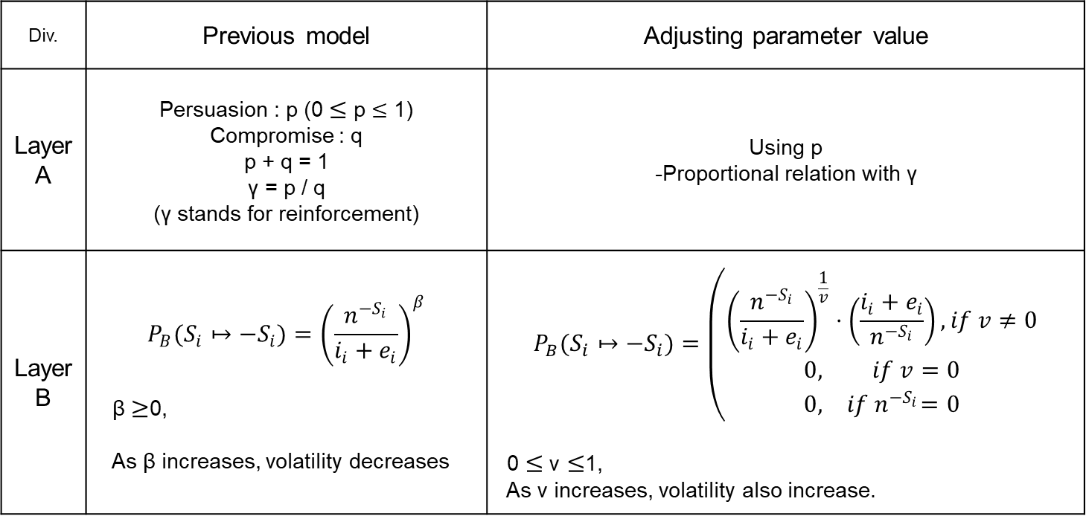
Adjusting Parameter value scale
Div. | Previous model | Adjusting parameter value
Layer A | Persuasion : p (0 $≤$ p $≤$ 1) Compromise : q p + q = 1 γ = p / q (γ stands for reinforcement) | Using p -Proportional relation with γ
Layer B | $$P_{B}(S_{i}↦−S_{i})={\left(\frac{n^{−S_{i}}}{i_{i}+e_{i}}\right)}^{β}$$ β $≥$0, As β increases, volatility decreases | $$P_{B}(S_{i}↦−S_{i})=\left(\begin{matrix}{\left(\frac{n^{−S_{i}}}{i_{i}+e_{i}}\right)}^{\frac{1}{v}}⋅\left(\frac{i_{i}+e_{i}}{n^{−S_{i}}}\right),if v≠0 \\ 0, if v=0 \\ 0,{ if n}^{−S_{i}}=0\end{matrix}\right.$$ 0 $≤$ v $≤$1, As v increases, volatility also increase.
With new parameter scales, though network structures are changed, it doesn’t need to change parameter scales. And the same scales of two parameters make it easy to compare two parameters.
Notes:
First, Adjusting parameter value scale. In layer A, there exists p and q. p scale is 0 to 1. And p is proportional relation with gamma. So we use p as new parameter value.
In layer B, volatility scale is adjusted from 0 to 1. So the dynamics equations is like this. In this equation, as v increases, volatility also increase.
With new parameter scales, though networks structures are changed, it doesn’t need to change parameter scales. And the same scales of two parameters make it easy to compare two parameters.

Slide 5
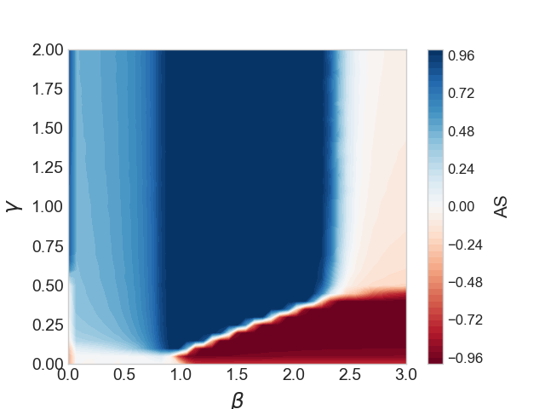
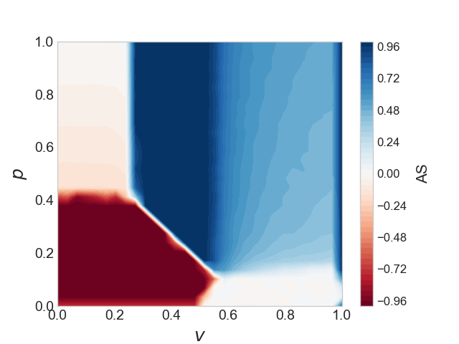
Simulation result with Adjusted Parameter value scale
Previous model
Adjusted model
①
①
②
①
②
①
③
③
Main features of models are almost same.
① When volatility is large enough or volatility is small enough, there exist coexistence parts.
② When reinforcement is large enough with certain volatility range, there exists positive consensus.
③ When reinforcement and volatility are small enough, there exists negative consensus.
Notes:
Next, simulation result with adjusted parameter value scale. Left figure is previous one. And right figure is adjusted result. Though it is not perfectly same with previous one, main features of models are almost same.
Number one, when volatility is large enough or small enough, there exists coexistence parts.
Number two, when reinforcement is large enough with certain volatility range, there exists positive consensus.
Number three, when reinforcement and volatility are small enough, there exists negative consensus.

Slide 6
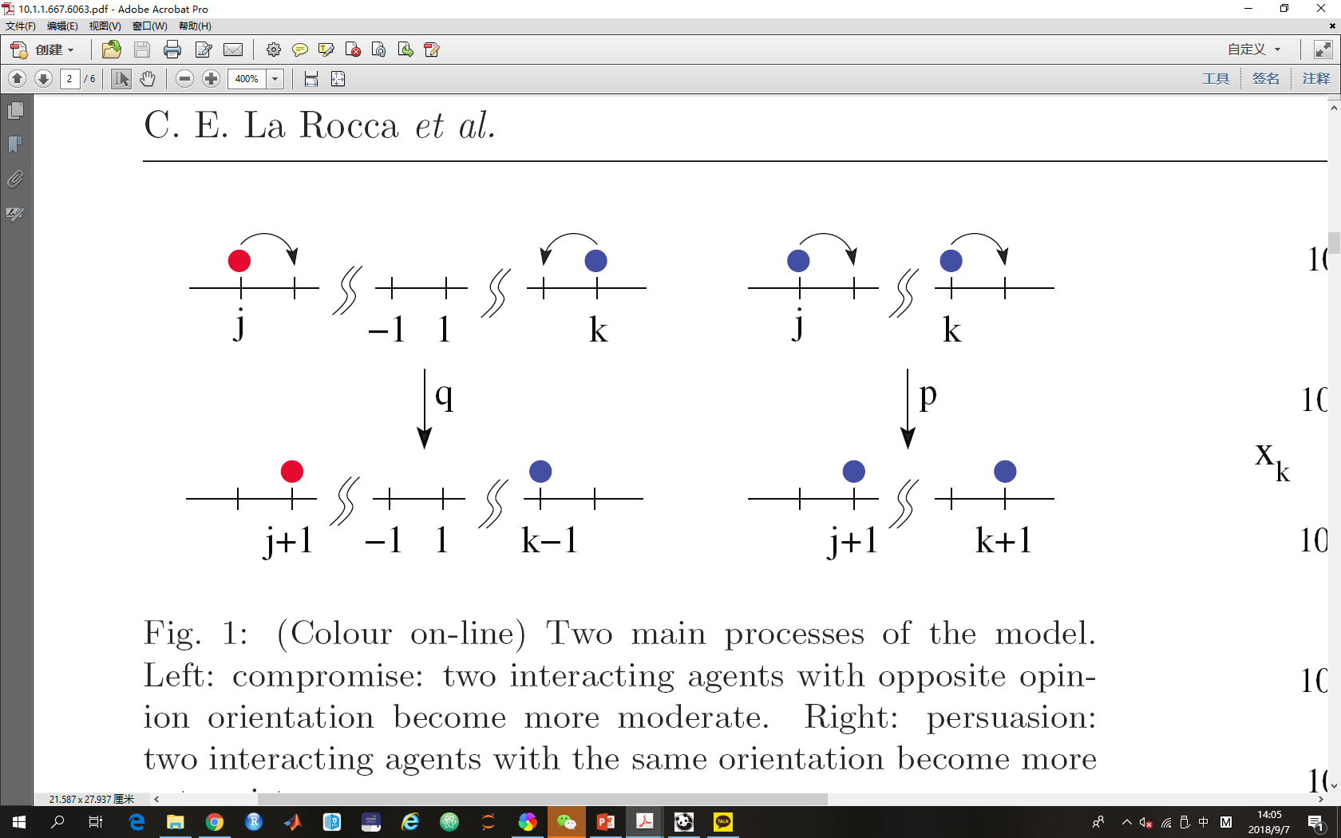
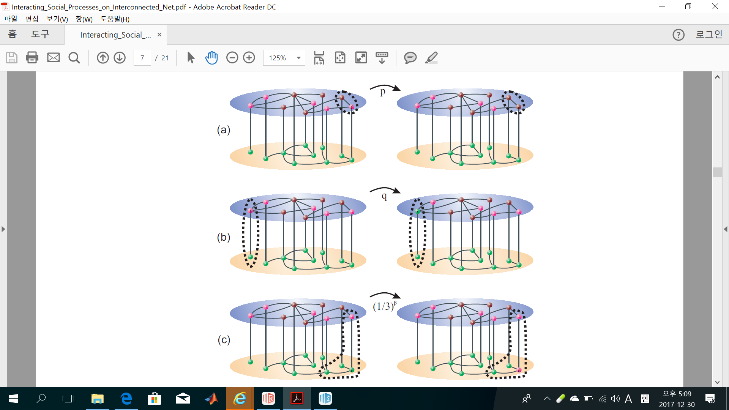
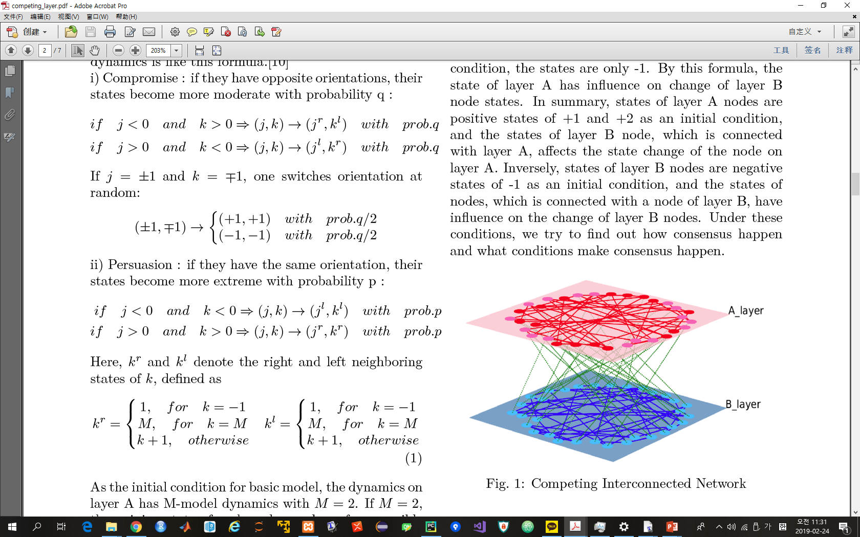
Calculating persuasion and compromise probabilities
Dynamics Algorithm for layer A
M-Model(The influence of persuasion in opinion formation and polarization)
This model can have many states that
are changed by probability p and q
that is p + q = 1, γ = p / q
* Reinforcement(γ) : the tendency to keep intensity
compromise(probability p) : same orientation,
increasing intensity
persuasion(probability q) : opposite orientation,
decreasing intensity
All edges are considered to update the states of nodes.
Notes:
Next, calculating persuasion and compromise probabilities.
This is dynamics algorithm for layer A. All edges in layer A are considered with probability p and q, and the states of node are updated.

Slide 7
Calculating persuasion and compromise probabilities
To simplify dynamics for layer A, each node needs to calculate the probabilities of changing state.
prob.p
prob.p
Through each node and its neighbor nodes,
we can calculate the probability of changing state.
prob.p
prob.p
prob.q
Notes:
Now, to simplify dynamics for layer A, each node needs to calculate the probabilities for changing state.
Like left figure, through each node and its neighbor nodes, we can calculate the probability of changing state.
This equation is the probability of updating states.

Slide 8
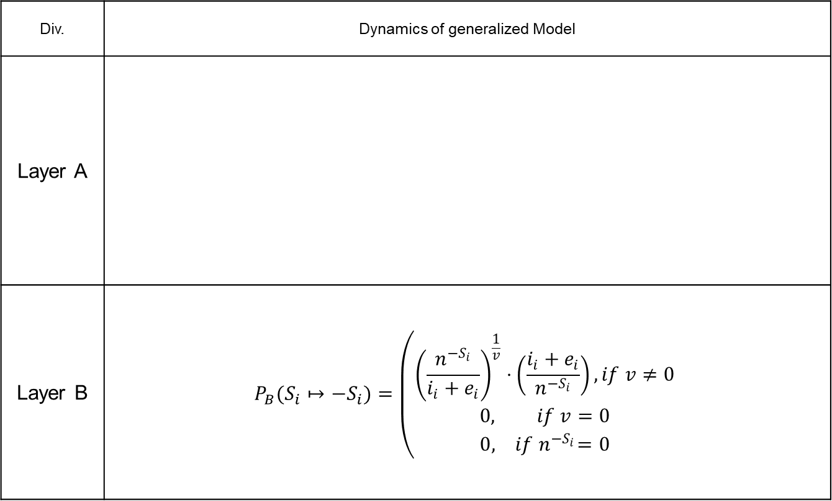
Dynamics of generalized model
Div. | Dynamics of generalized Model
Layer A
Layer B | $$P_{B}(S_{i}↦−S_{i})=\left(\begin{matrix}{\left(\frac{n^{−S_{i}}}{i_{i}+e_{i}}\right)}^{\frac{1}{v}}⋅\left(\frac{i_{i}+e_{i}}{n^{−S_{i}}}\right),if v≠0 \\ 0, if v=0 \\ 0,{ if n}^{−S_{i}}=0\end{matrix}\right.$$
Notes:
This is generalized model dynamics. Layer A dynamics follows this equation, and layer B follows this equation. All parameters scale is 0 to 1.

Slide 9
Considering dynamics order as updating rule
When considering dynamics order on two-layer networks,
there are many ways to update node states
Order between two layers | Order between nodes |  | remarks
Layer A → Layer B | Layer A | Step by Step | O(o) → D(o) O(o) → D(s) O(s) → D(o) O(s) → D(s)
 |  | Simultaneous
 | Layer B | Step by Step
 |  | Simultaneous
Layer B → Layer A | Layer A | Step by Step | O(o) ← D(o) O(o) ← D(s) O(s) ← D(o) O(s) ← D(s)
 |  | Simultaneous
 | Layer B | Step by Step
 |  | Simultaneous
Layer A ↔ Layer B (simultaneous) | Layer A | Simultaneous | O(s) ↔ D(s)
 | Layer B | Simultaneous
Layer A ⇔ Layer B (One node in layer A → One node in layer B) | Layer A | Step by Step | O(o) ⇔ D(o)
 | Layer B | Step by Step
Notes:
Next, I am considering dynamics order as updating rule. When considering dynamics order on two-layer networks, there are many ways to update node states.
First, order between two layers has to be considered, and then order between nodes also has to be considered.
Finally, there are 10 ways to update node states.
O stands for Opinion layer, D stands for Decision making layer, small o means ‘sequential order’, small s means ‘simultaneous’

Slide 10
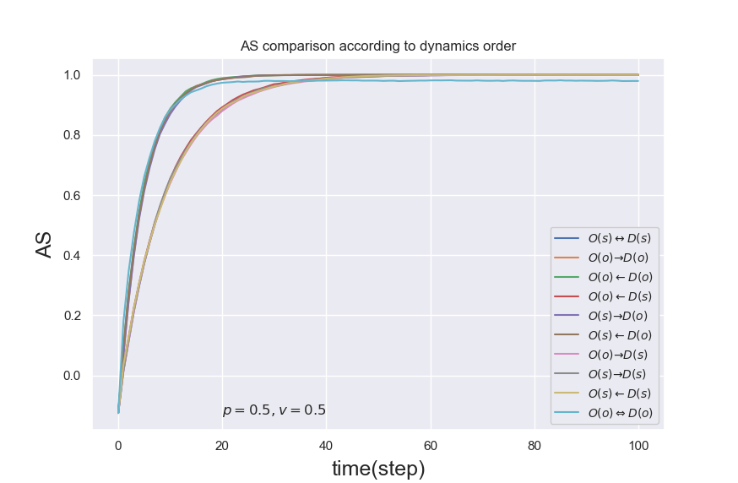
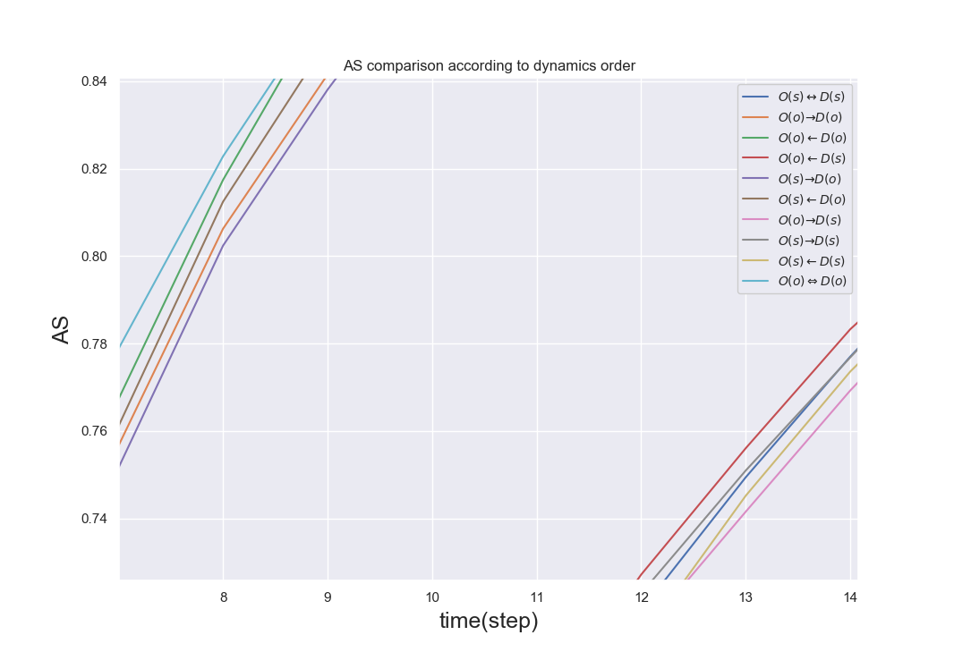
Simulation result with different dynamics order(1/2)
Order between two layers doesn’t matter for average state of two layers.
When layer B has simultaneous updating rule, simulation result is different from other simulations.
- In these figures, simultaneous updating rule of layer B make it slow to reach consensus and
make it hard to reach consensus.
Notes:
This is simulation result with different dynamics order.
Simulation results are divided into two categories, fast consensus, slow consensus.
Order between two layers doesn’t matter for average state of two layers.
When only layer B has simultaneous updating rule, simulation results have slow consensus.
- In these figures, simultaneous updating rule of layer B make it slow to reach consensus and make it hard to reach consensus.

Slide 11
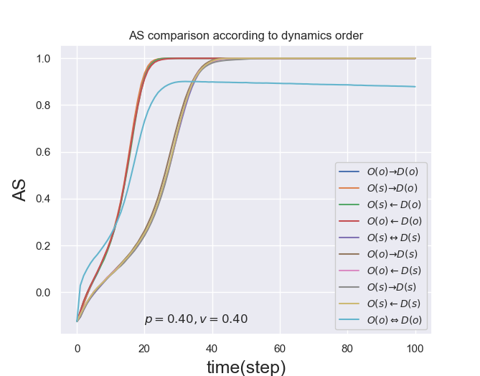
Simulation result with different dynamics order(2/2)
In this figure, only skyblue one didn’t reach consensus.
That means too many interacted updating rules between two layers make it hard to reach consensus.
Notes:
These result with different parameters.
In these figure, only skyblue one didn’t reach consensus. Skyblue one is for the case where one node in layer A is updated, and then one node in layer B is updated until all nodes are checked. That means too many interacted updating rules between two layers make it hard to reach consensus.

Slide 12
Future Research
Simulating with generalized model
- comparison with previous models
Finding key node and edge
- Based on node centralities, the state of a node with maximum centralities would
not be changed. And it would be investigated that which properties have more
influence to change the state of two-layers.
* node centralities : pagerank, betweenness, HIT and so on
- However, a node with maximum pagerank, betweenness or HIT would be almost
same one. So, each node centralities would be ranked. As ratio of unchanged node
is increased according to ranked nodes order, the state of two-layers would be
investigated.
Notes:
As future research.
I will simulate with generalized model and compare with previous model.
Next, I try to find key nodes and edges.
Based on node centralities, the state of a node with maximum centralities would be changed.
And it would be investigated that which properties have more influence to change the state of two-layers. As node centralities, I would use pagerank, betweenness, HIT Algorithm.
However, a node with maximum pagerank, betweenness or HIT would be almost same one. So, each node centralities would be ranked.
As ratio of unchanged node is increased according to ranked nodes order, the state of two-layer would be investigated.

Slide 13
Thank you
Notes:
Thank you.

Slide 14
① prob.p
② prob.p
Order of edges | Next state
Sequential | Hard to calculate (According to order of activated edges, final state is changed)
Simultaneous | Unchanged: prob.p(activated) = prob.q(activated) Persuasion : prob.p(activated) > prob.q(activated) Compromise: prob.p(activated) < prob.q(activated)
④ prob.p
③ prob.p
⑤ prob.q

Slide 15
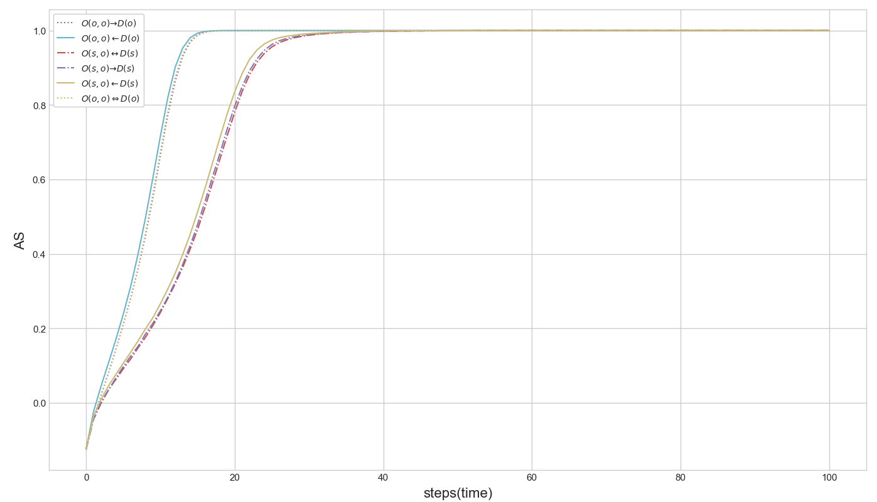
Div | Fast Consensus | Slow Consensus
Orders | ① O(o, o) ← D(o) ② O(o, o) ⇔ D(o) ③ O(o, o) → D(o) | ④ O(s, o) ← D(s) ⑤ O(s, o) → D(s) ⑥ O(s, o) ↔ D(s)

Slide 16
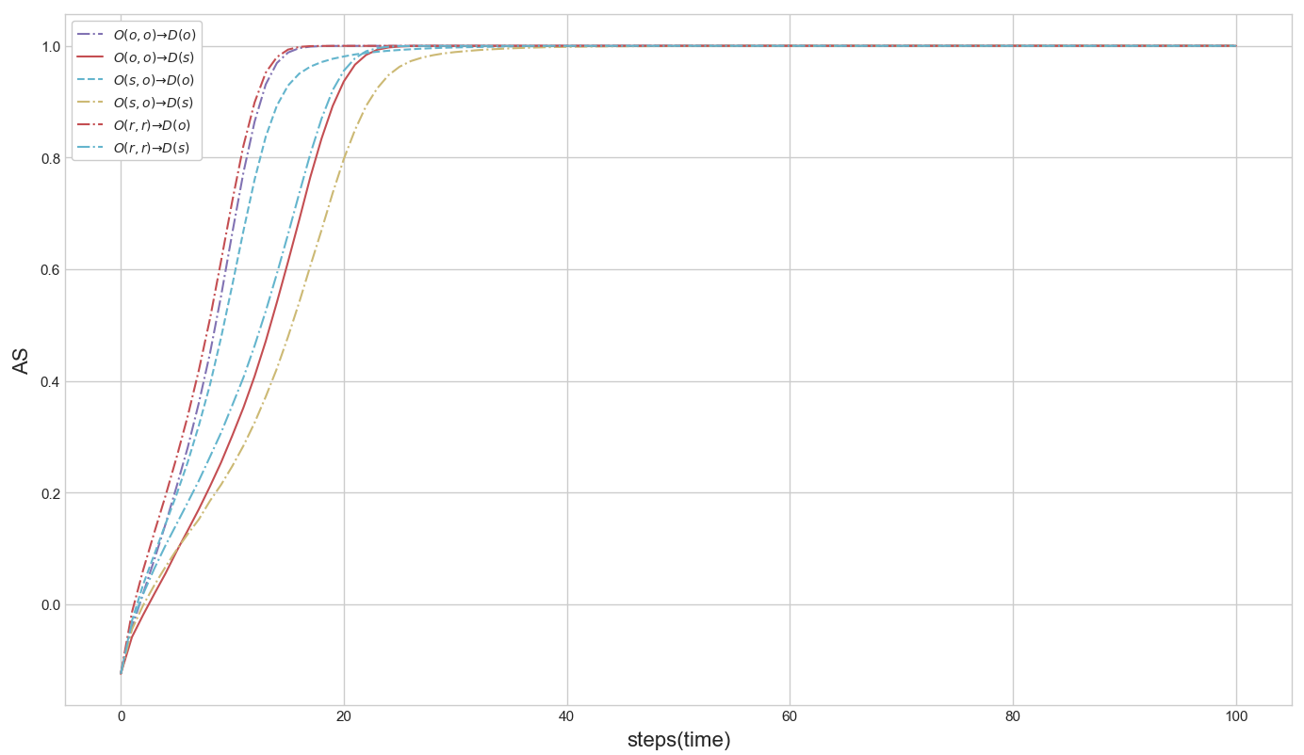
Div | Fast Consensus | Slow Consensus
Orders | ① O(r, r) → D(o) ② O(o, o) → D(o) ③ O(s, o) → D(o) | ④ O(r, r) → D(s) ⑤ O(o, o) → D(s) ⑥ O(s, o) → D(s)

Slide 17
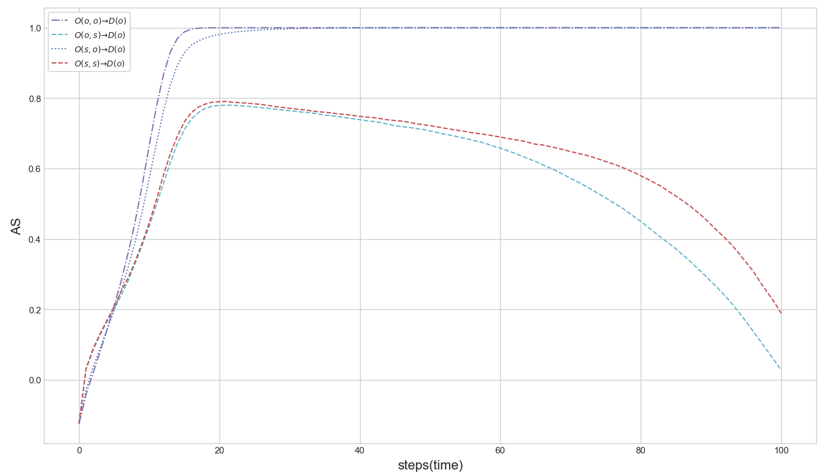
Div | Consensus | Not reaching consensus
Orders | ① O(o, o) → D(o) ② O(s, o) → D(o) | ③ O(o, s) → D(o) ④ O(s, s) → D(o)

Slide 18
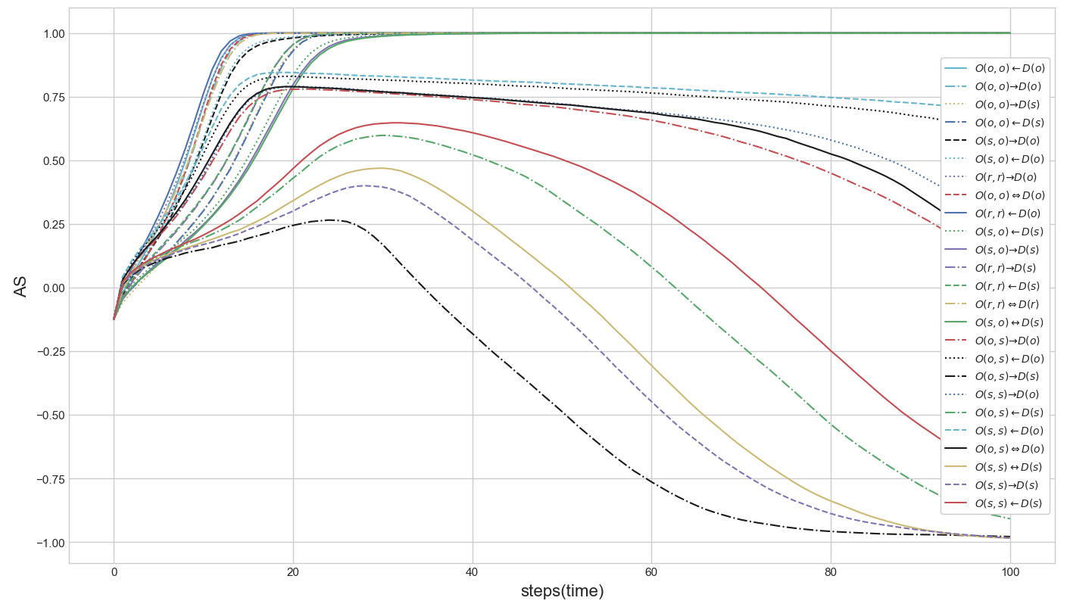
Div | Positive Consensus (close to positive) | Coexistence | Negative Consensus (close to negative)
Orders | O(r, r) ← D(o) O(r, r) → D(o) O(o, o) ← D(o) O(o, o) ⇔ D(o) O(o, o) → D(o) O(r, r) ⇔ D(r) O(r, r) → D(s) O(r, r) ← D(s) O(o, o) → D(s) O(o, o) ← D(s) O(s, o) ← D(o) O(s, o) → D(o) O(s, o) ← D(s) O(s, o) → D(s) O(s, o) ↔ D(s) | O(s, s) ← D(o) O(o, s) ← D(o) O(s, s) → D(o) O(o, s) ⇔ D(o) O(o, s) → D(o) | O(s, s) ← D(s) O(o, s) ← D(s) O(o, s) → D(s) O(s, s) → D(s) O(s, s) ↔ D(s)

Slide 19
Div | Positive Consensus (close to positive) | Coexistence | Negative Consensus (close to negative)
Orders | ① O(r, r) ← D(o) ② O(r, r) → D(o) ③ O(o, o) ← D(o) ④ O(o, o) ⇔ D(o) ⑤ O(o, o) → D(o) ⑥ O(r, r) ⇔ D(r) ⑦ O(r, r) → D(s) ⑧ O(r, r) ← D(s) ⑨ O(o, o) → D(s) ⑩ O(o, o) ← D(s) ⑪ O(s, o) ← D(o) ⑫ O(s, o) → D(o) ⑬ O(s, o) ← D(s) ⑭ O(s, o) → D(s) ⑮ O(s, o) ↔ D(s) | ① O(s, s) ← D(o) ② O(o, s) ← D(o) ③ O(s, s) → D(o) ④ O(o, s) ⇔ D(o) ⑤ O(o, s) → D(o) | ① O(s, s) ← D(s) ② O(o, s) ← D(s) ③ O(o, s) → D(s) ④ O(s, s) → D(s) ⑤ O(s, s) ↔ D(s)

Slide 20
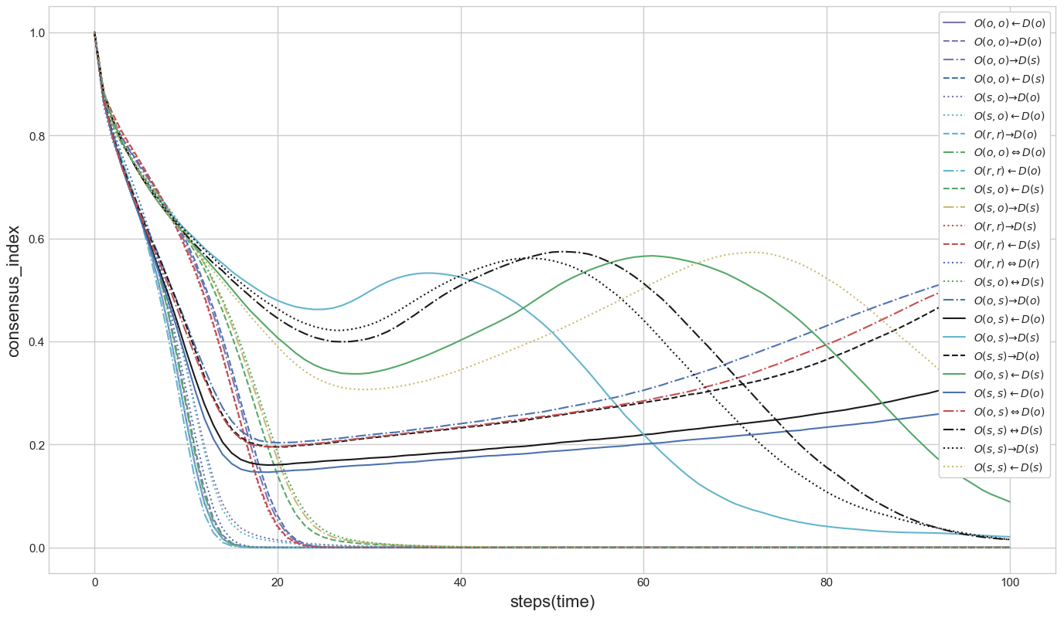
① Branch point
③ Branch point
② Branch point
Div. |  | States | Orders
① Branch point | ② Branch point : Sequential order of node in layer B | Fast positive consensus : Sequential order of edge | O(r, r) ← D(o) O(r, r) → D(o) O(o, o) ← D(o) O(o, o) ⇔ D(o) O(o, o) → D(o) O(r, r) ⇔ D(r) O(s, o) ← D(o) O(s, o) → D(o)
 |  | Coexistence : Simultaneous order of edge | O(s, s) ← D(o) O(o, s) ← D(o) O(s, s) → D(o) O(o, s) ⇔ D(o) O(o, s) → D(o)
 | ③ Branch point : Simultaneous order of node in layer B | Slow positive consensus : Sequential order of edge | O(r, r) → D(s) O(r, r) ← D(s) O(o, o) → D(s) O(o, o) ← D(s) O(s, o) ← D(s) O(s, o) → D(s) O(s, o) ↔ D(s)
 |  | Slow negative consensus : Simultaneous order of edge | O(s, s) ← D(s) O(o, s) ← D(s) O(o, s) → D(s) O(s, s) → D(s) O(s, s) ↔ D(s)

Slide 21
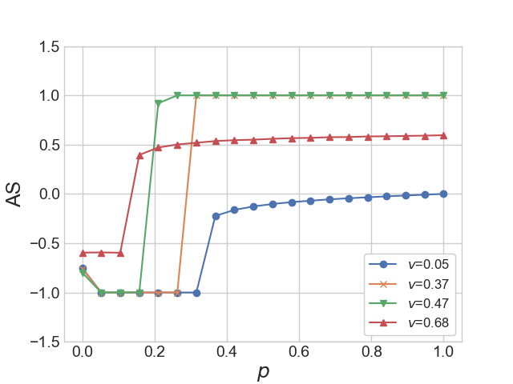
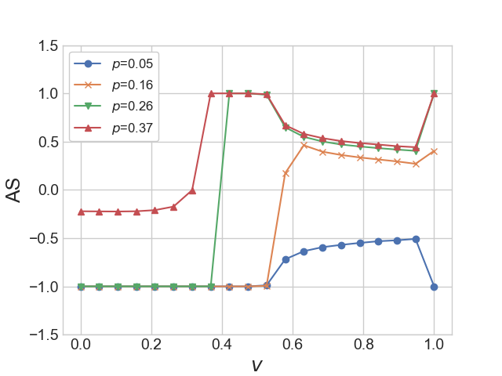
(a)
(b)

Slide 22
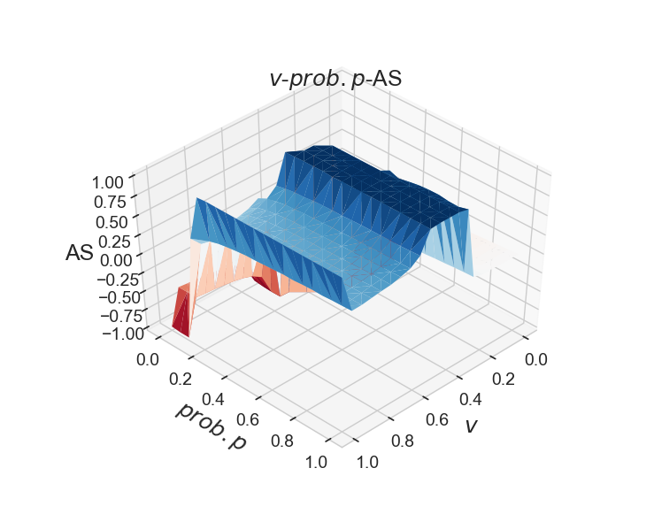
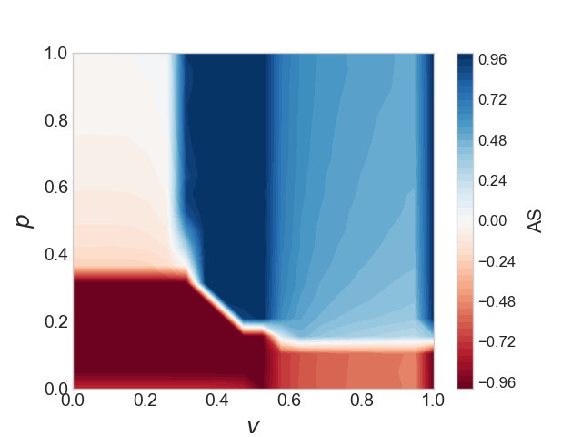
(a)
(b)

